Slide 1
Assessment Type 1 Task 1 AWS Sustainability IoT Hackathon - (Collaborative)
SACE ID - 671489F

Slide 2
Brief
● Learn about the United Nations Sustainability Development Goals and how technology can be used to achieve them
● Use collaborative programming methods to learn both hard and soft skills
● Program IoT devices with a visual programming language built on Python to allow beginners and experts to work together
● Gain confidence that I can succeed in a technology role Assessment conditions
Product: 5-minute (Maximum) Multimodal Presentation
Evidence via:
● Podcast / Vlog / Video / Presentation / Digital Whiteboarding

Slide 3
Pre-Planning
Before we'd started the practical work, our class had a discussion of the 17 Sustainable Development Goals (SDGs) and what they mean from a corporate perspective and a livelihood perspective, and how they can intertwine with some of the goals.
The two SDGs the class chose to focus on was goal no.2 and no.6, zero hunger and clean water and sanitation, as it was and still is a current, relevant issue which we face across the globe.
Collectively we decided the base idea for an end goal was to process and develop a device which can water a plant when certain conditions are met which would require being watered, such as the soil drying or temperature dipping/peaking, while at the same time making it easy to understand and sustainably reliable.

Slide 4
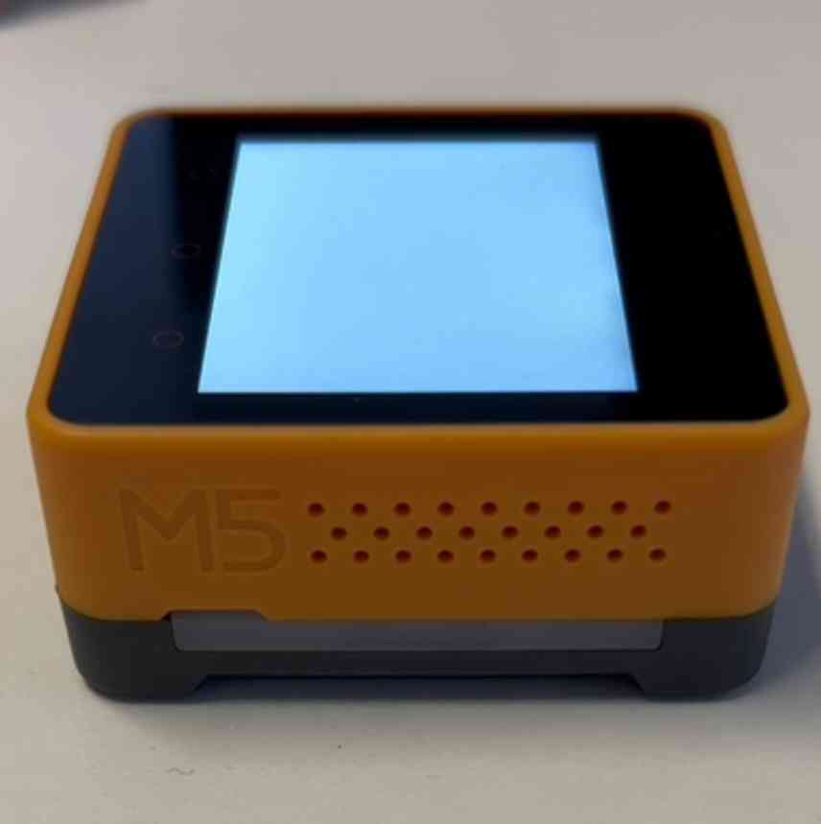
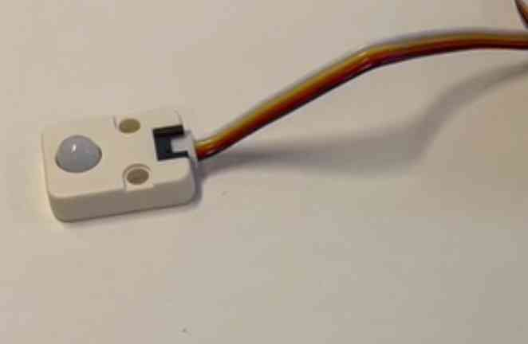
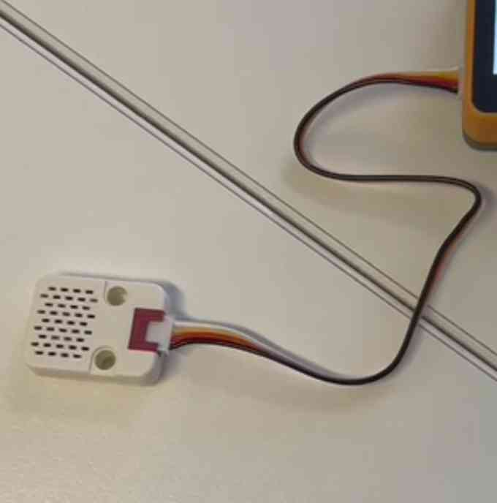
About to begin/ kit contents
Upon presenting our idea for our task (make an IoT device to water a plant) to AWS, they supplies us with a kit which contained the necessary components to build our device.
CORE-2 Module
The main cell which the other components attach onto. Connects with the Ui Flow website to receive inputs and sequences of command events. Capable of producing sound (speakers as shown), displaying text, images and colours on the screen, and attaching multiple components such as the following pieces to display different data readings in multiple forms.
Receives, contains and displays data.
Motion Sensor
This piece is attached to the core-2 module and allows it to process whether activity is detected in front of the reader itself (the grey ball). On large scale research-based projects, could be useful for detecting growth patterns in a plant, or even to communicate if unwanted critters are residing in the plant.
Receives and disperses data.
Environmental quality Reader:
This piece is attached to the core-2 module and allows it to process and display readings of temperature, humidity, moisture and pressure on its surroundings; an integral piece for collecting data pertaining our plants' health.
Receives, contains and disperses data.

Slide 5
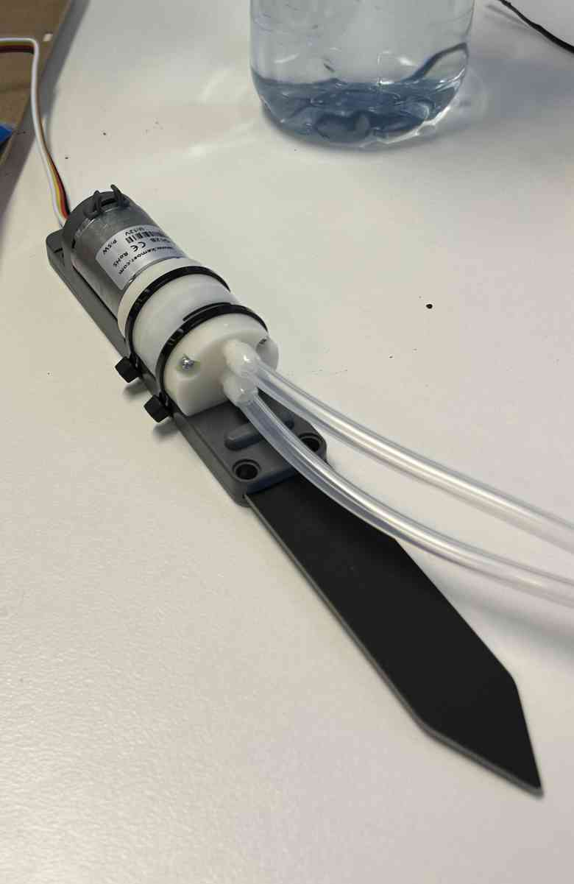
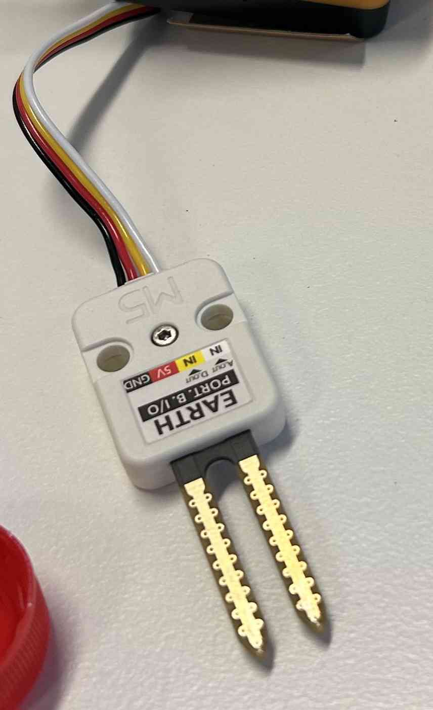
Motor-Powered irrigation/water pump
A powerful component attached to the core-2 module capable of receiving and dispersing water from a source to an end point via tubes running along from the storage source. Requires self-provided source such as a bottle or cup full of water. Pumping rate set at a steady reasonable rate which by combining the data some of the other components offer, can allow an easy to manage and hard to fault supplier. The arrowhead pick feeds through the dirt for stability.
Receives data.
About to begin/ kit contents
Earth moisture reader
This piece is attached to the core-2 module and allows it to process and display 2 readings (analog and digital) on current activity regarding soil moisture via the 2 prongs connected to the body. This is done by sending an electrical signal between the 2 and, depending on the interference/clarity of the signal, can dictate whether the supplied earth is too moist or not moist enough.
Receives, contains and disperses data.

Slide 6
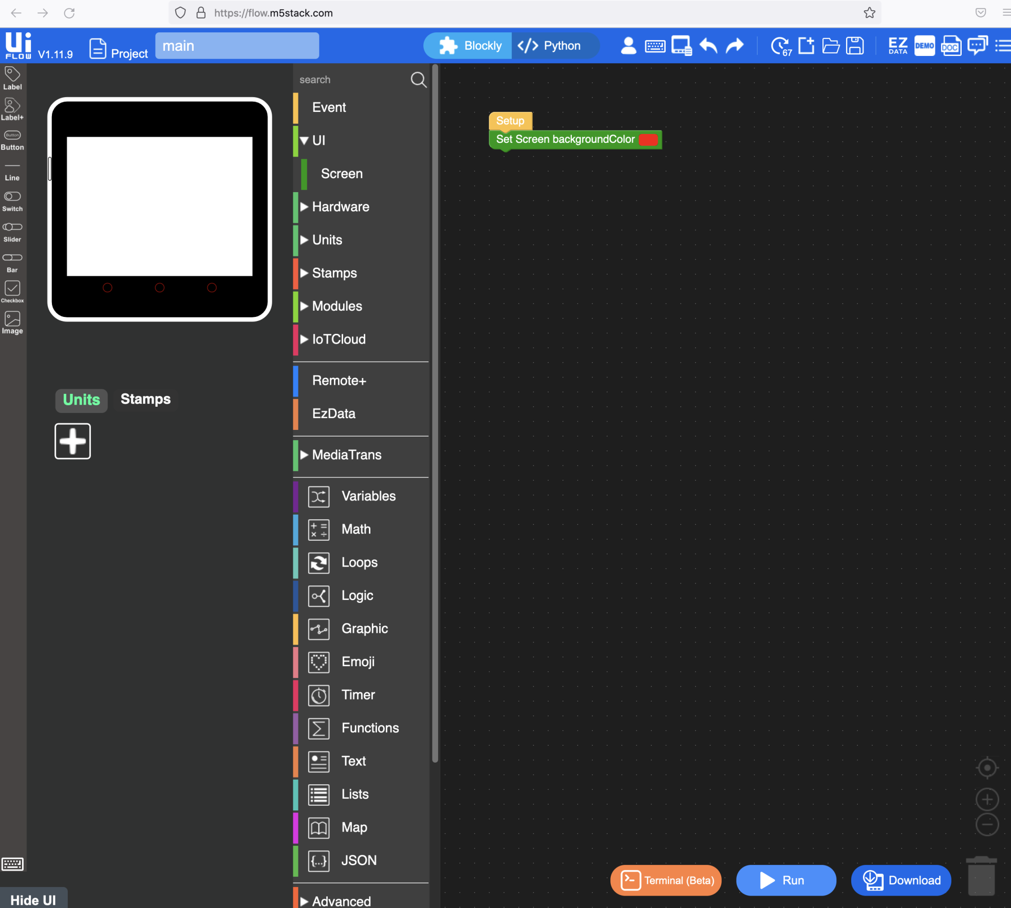
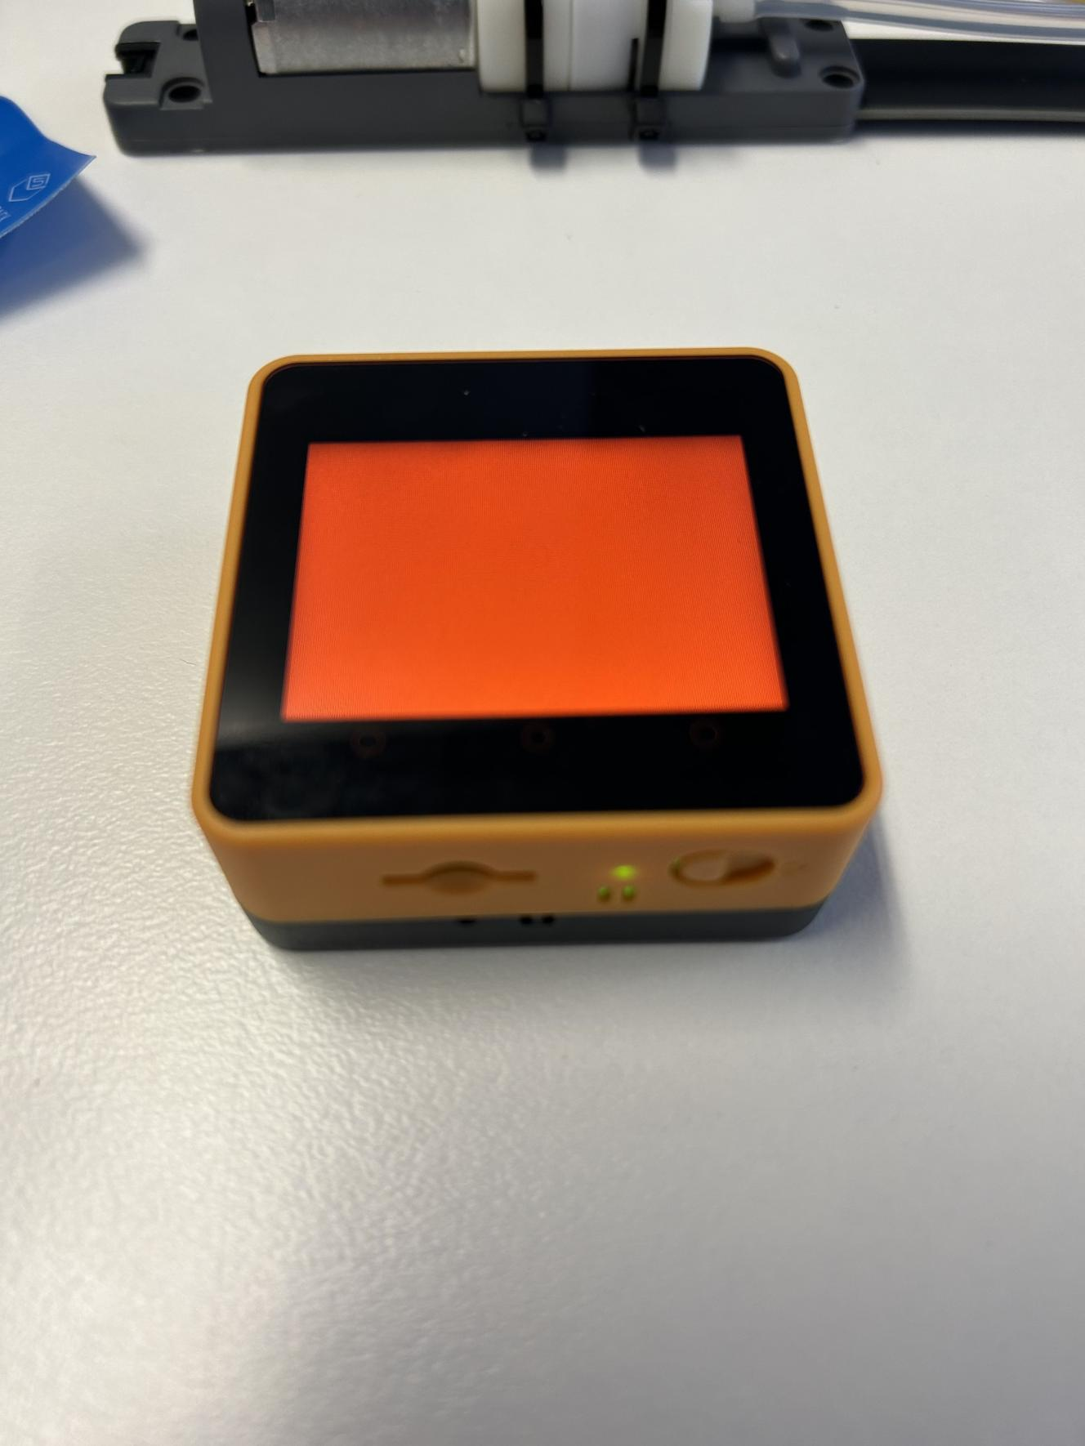
The design process - visuals
To start the day off we thought it'd be best for a revision to be in session. The supply kits we were gifted by the Amazon Web Services team (AWS) contained all the gear we'd needed to achieve our goal, thus running some simple tests could gain us a deeper understanding on how to use the devices.
To make sure it worked, we ran a test to see if the display was responsive to our commands.
Overall the test worked meaning we could proceed, however, even if we knew the display worked, we hadn't checked to see if sounds were responsive, or possible for that matter.

Slide 7
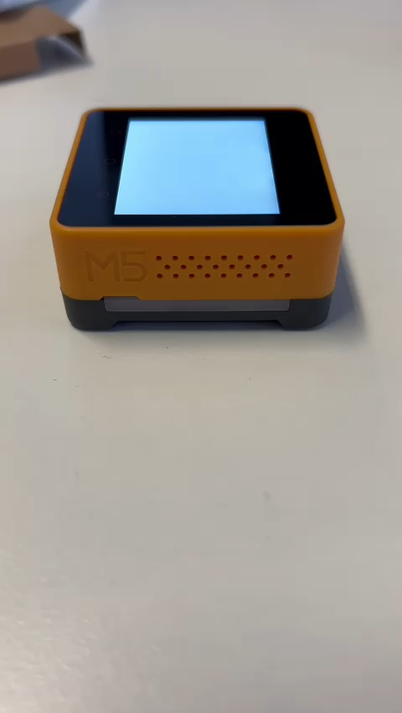
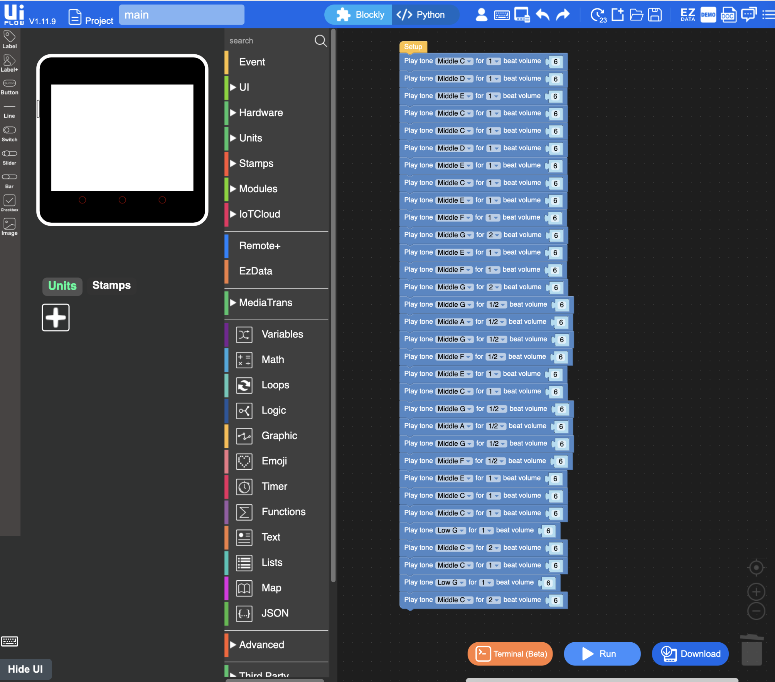
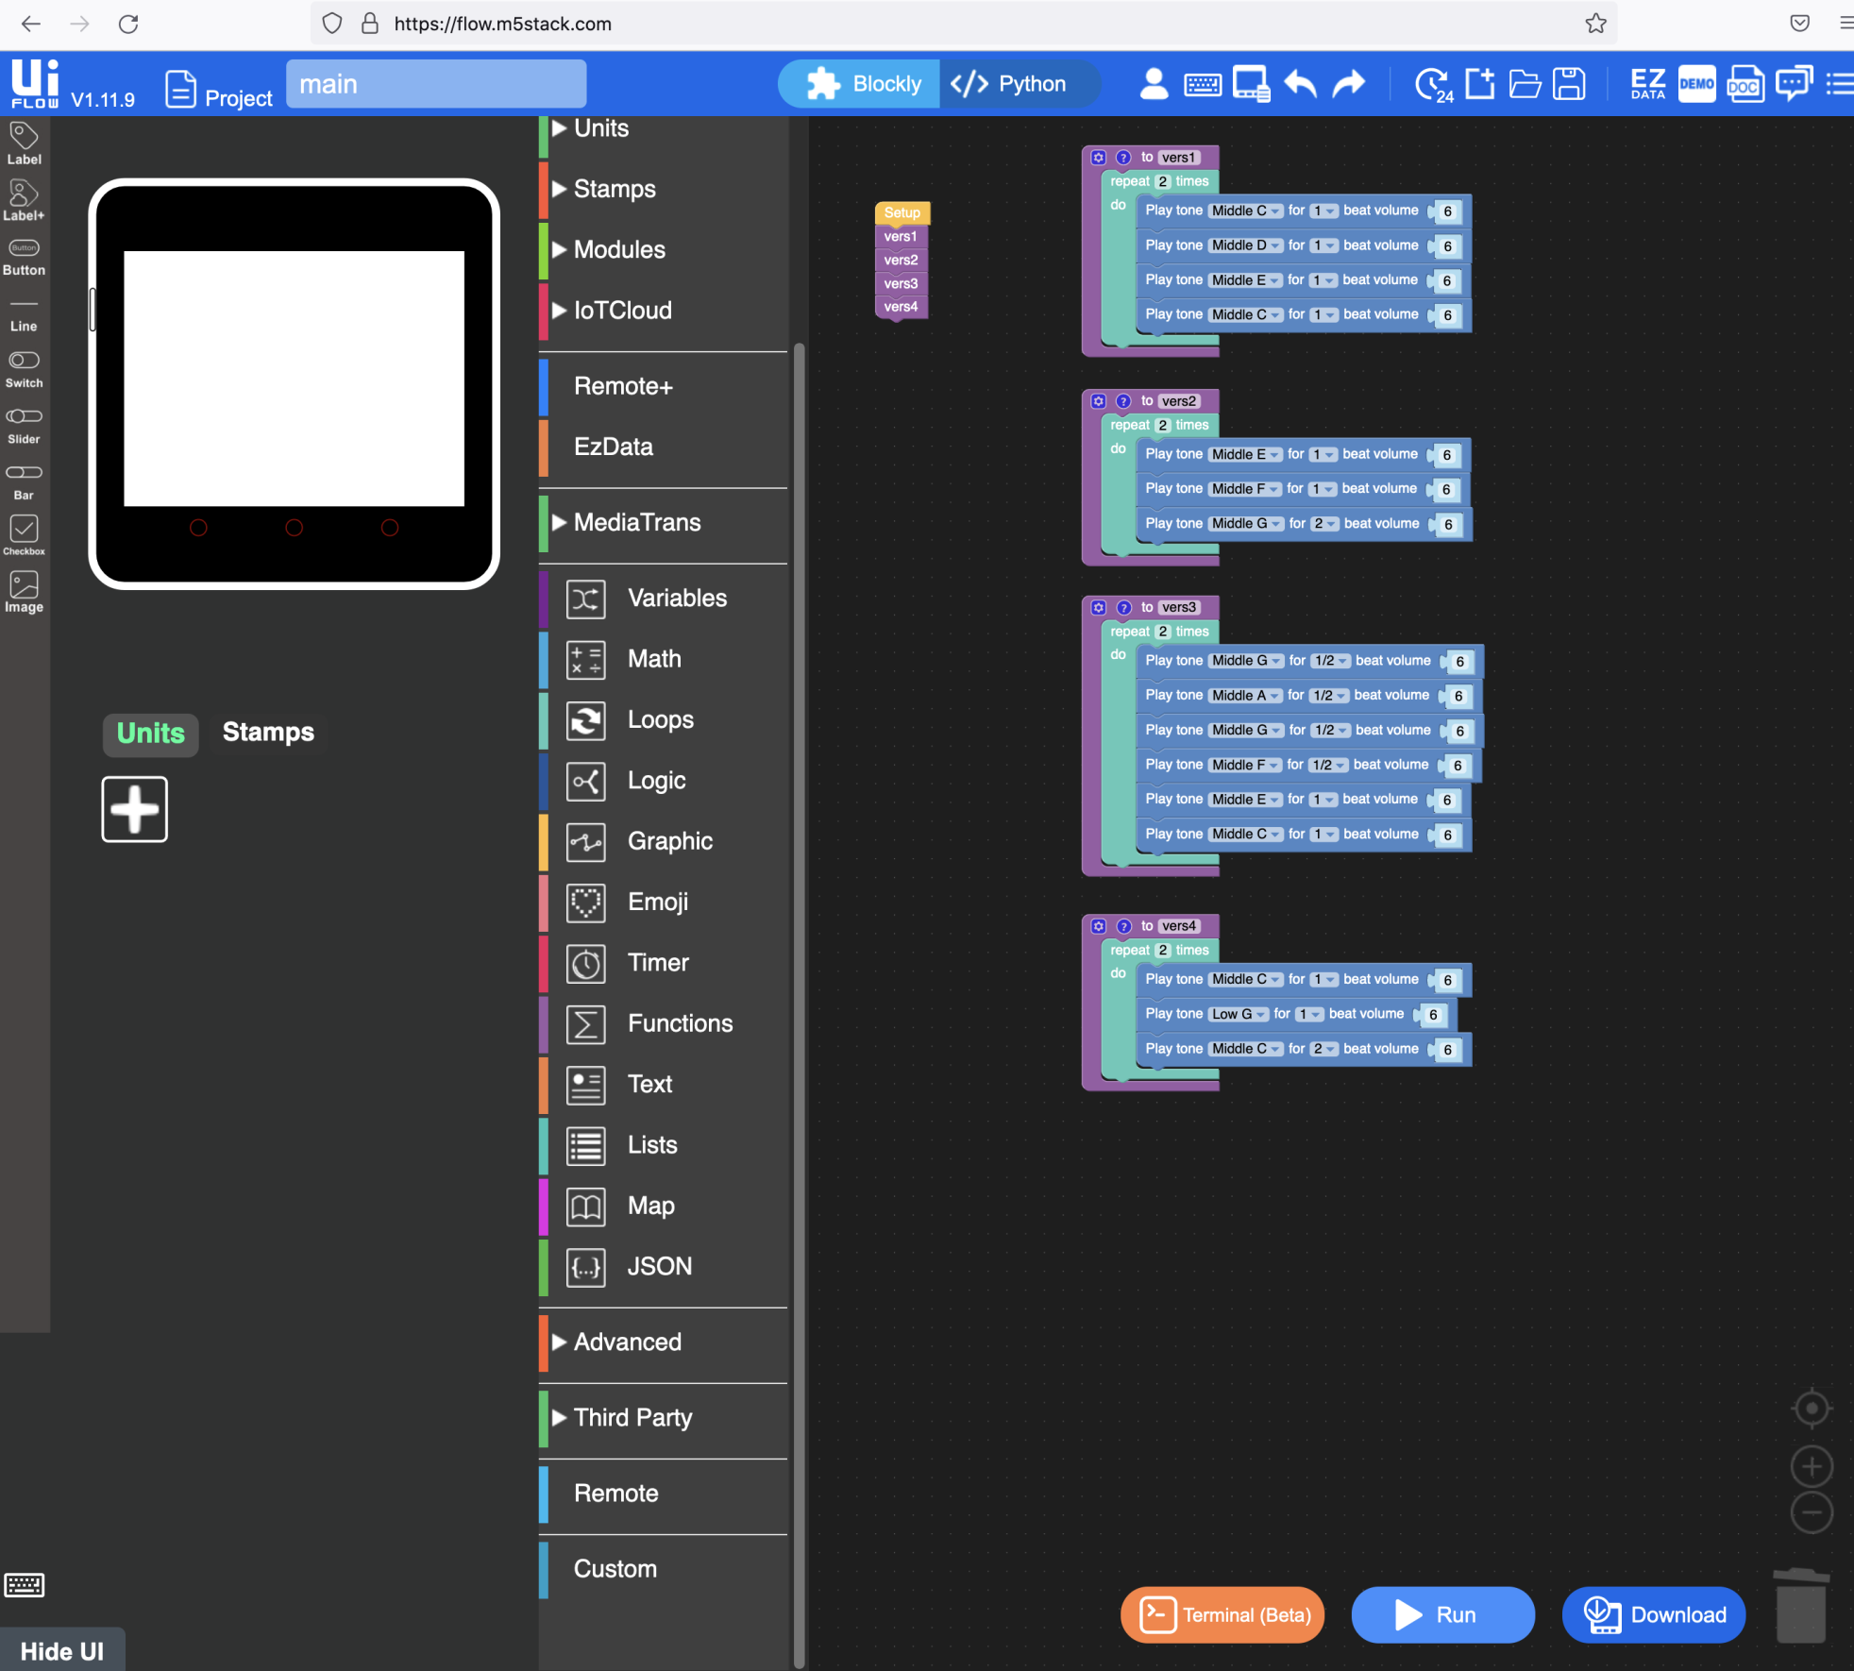
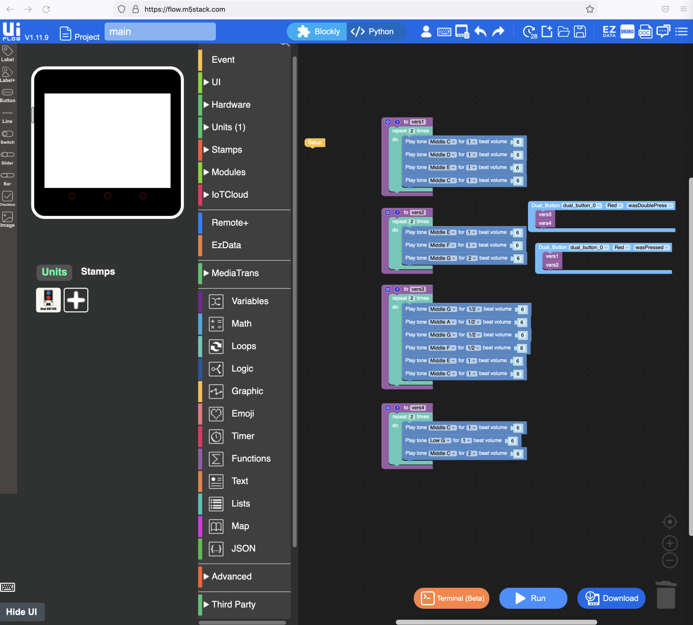
The design process - audio
To see if sound were to work, we ran the fairly complicated task of reciting certain note sounds in order to form a coherent song. The following clip and screenshots proves we achieved just that:
The key information to take away from this experiment was that the test was conducted three times. All three times, we'd alter the script to be more compact with each new iteration.

Slide 8
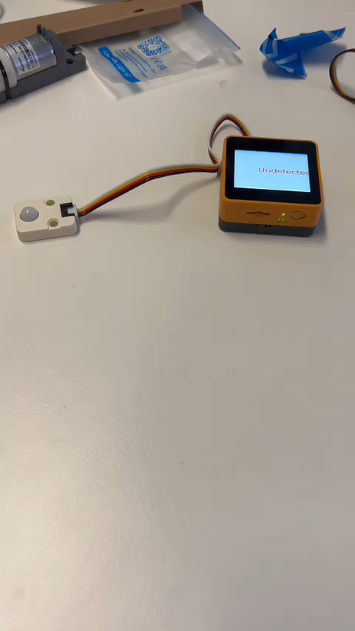
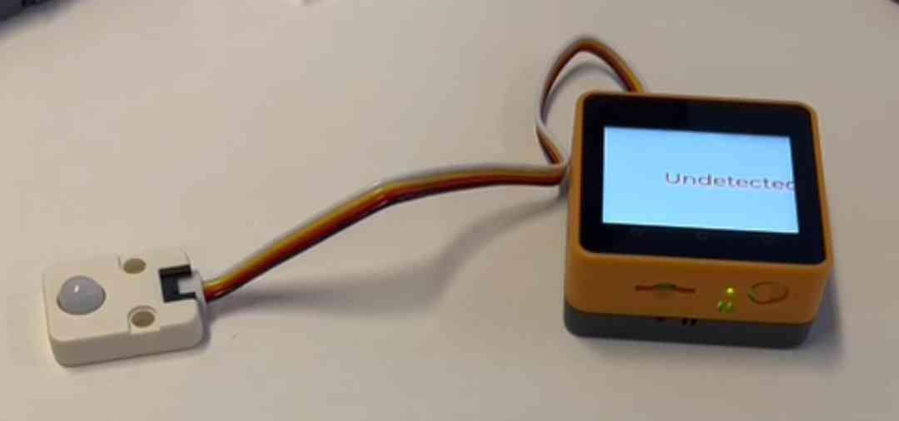
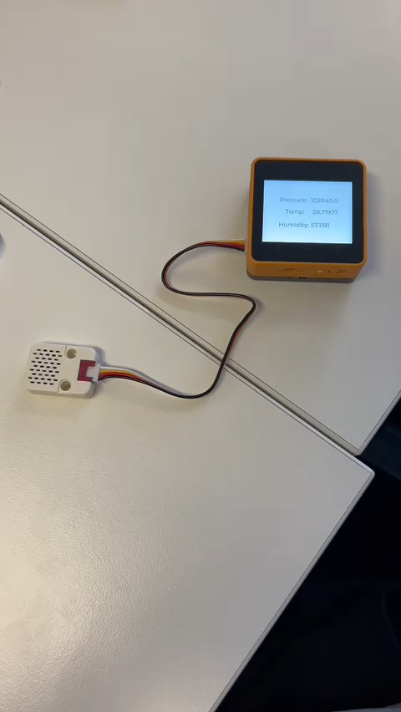
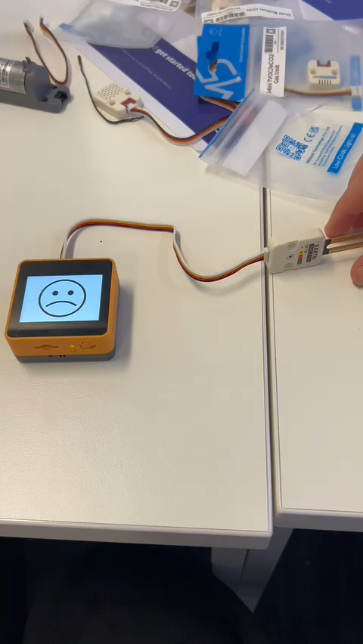
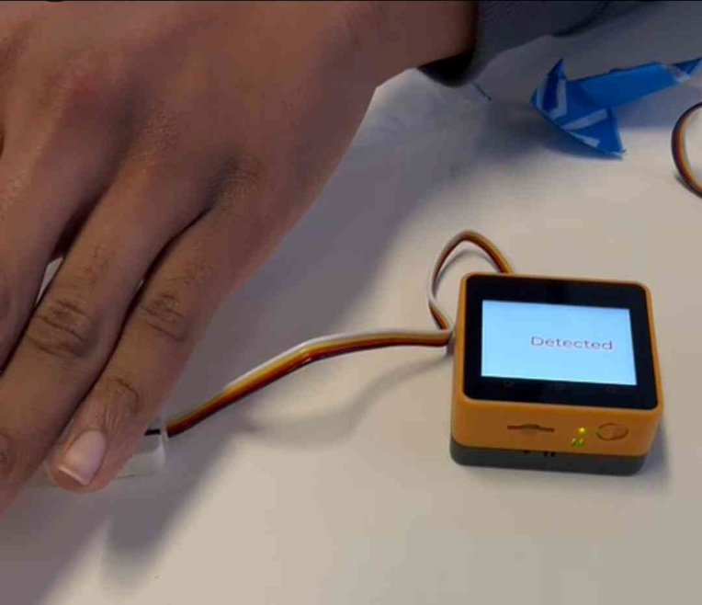
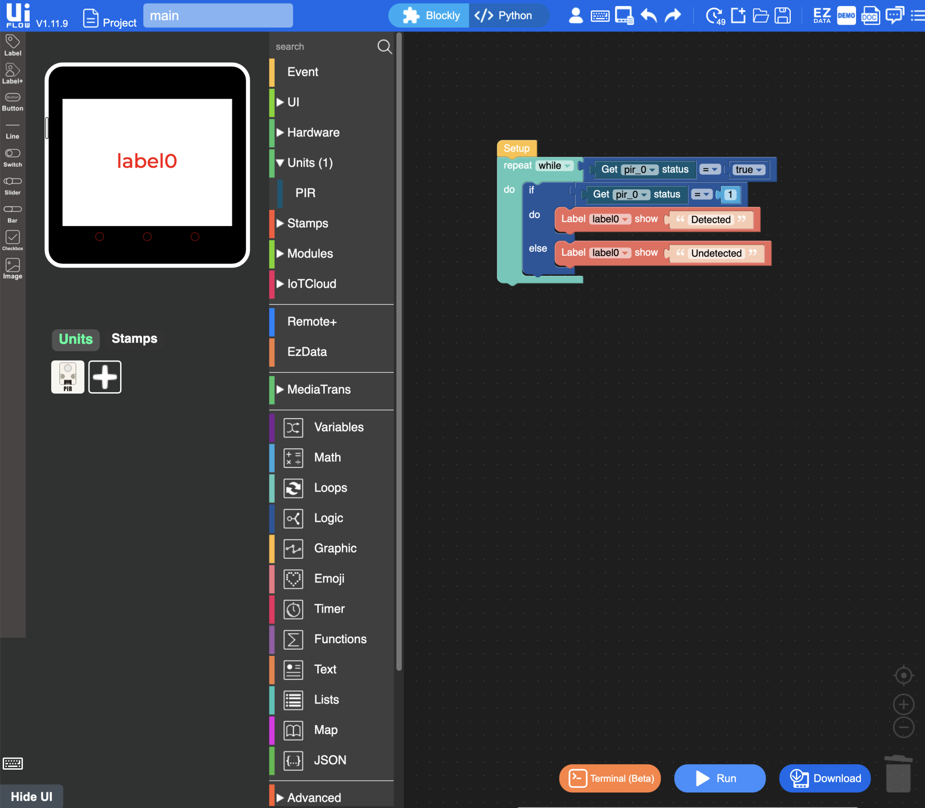
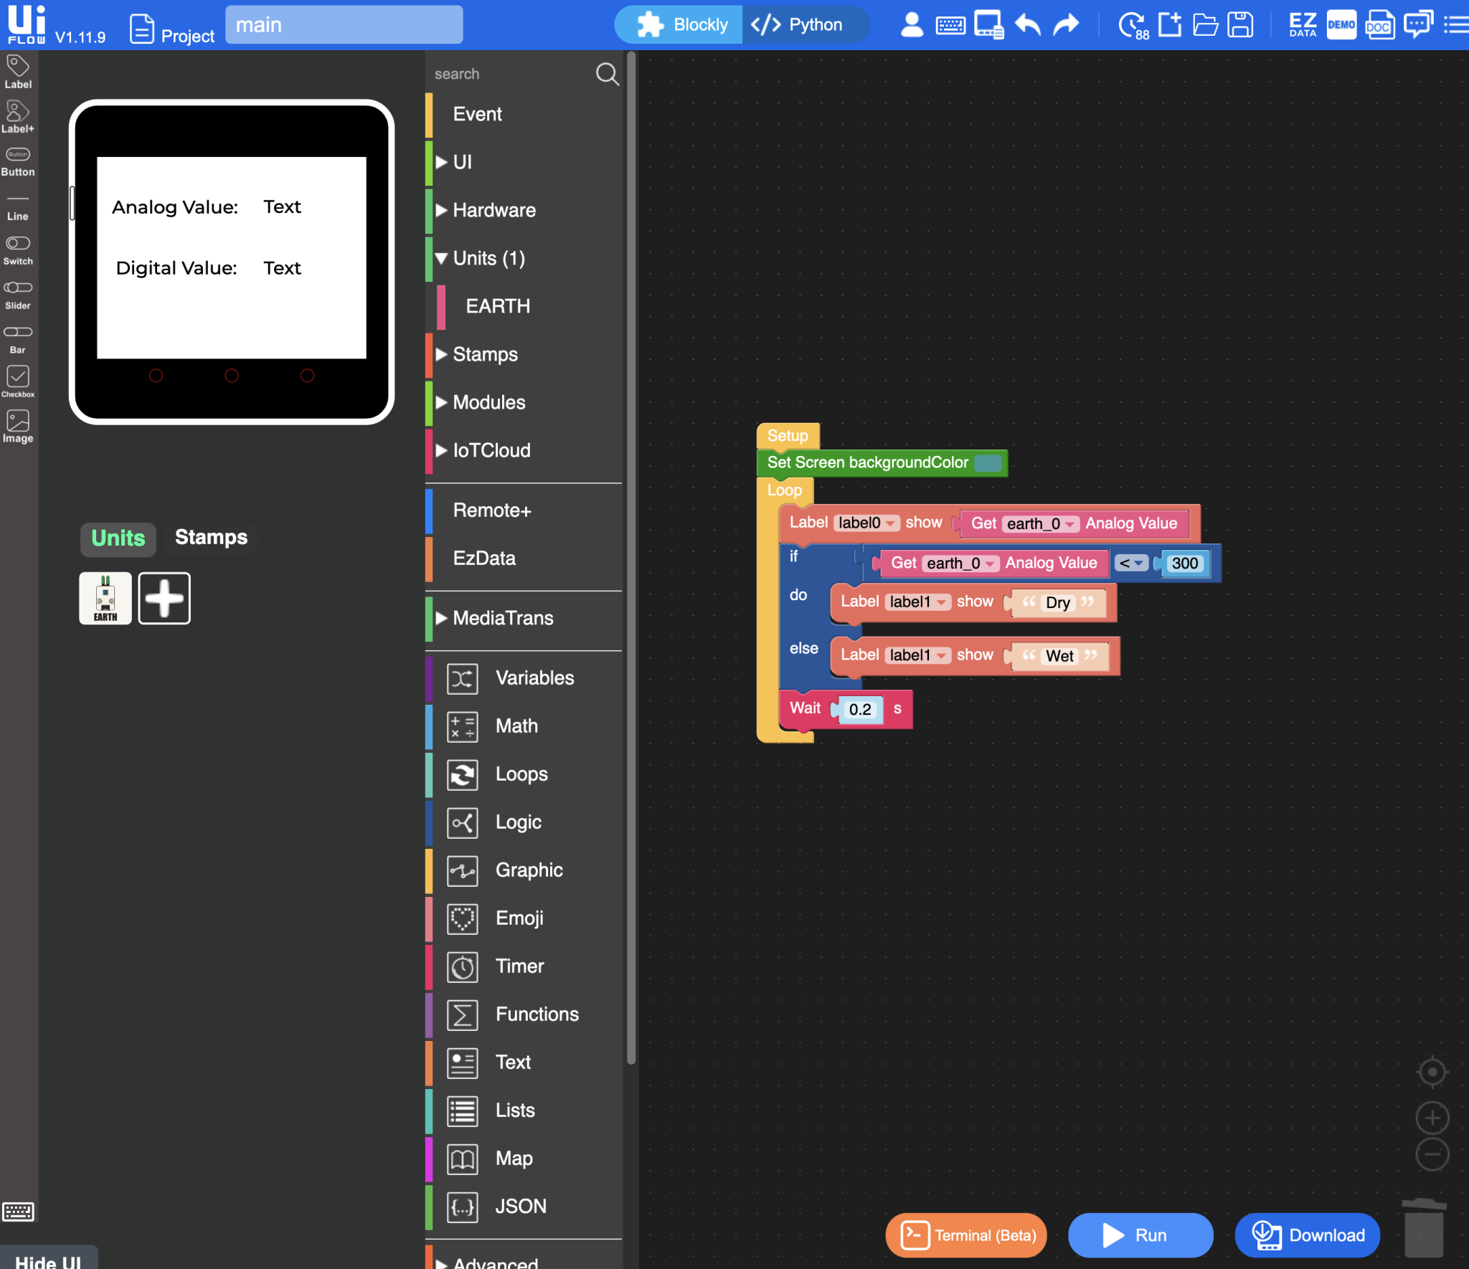
Practical work – Road to achieving the goal
In order to create the device to water the plant, we needed to link the components which could tell the required data we had to know so the pump could water the plant.
After an hour of troubleshooting each component, we'd finally received a form of feedback from each, meaning that they all work. It was now time to combine all the data and components with the pump device.

Slide 9
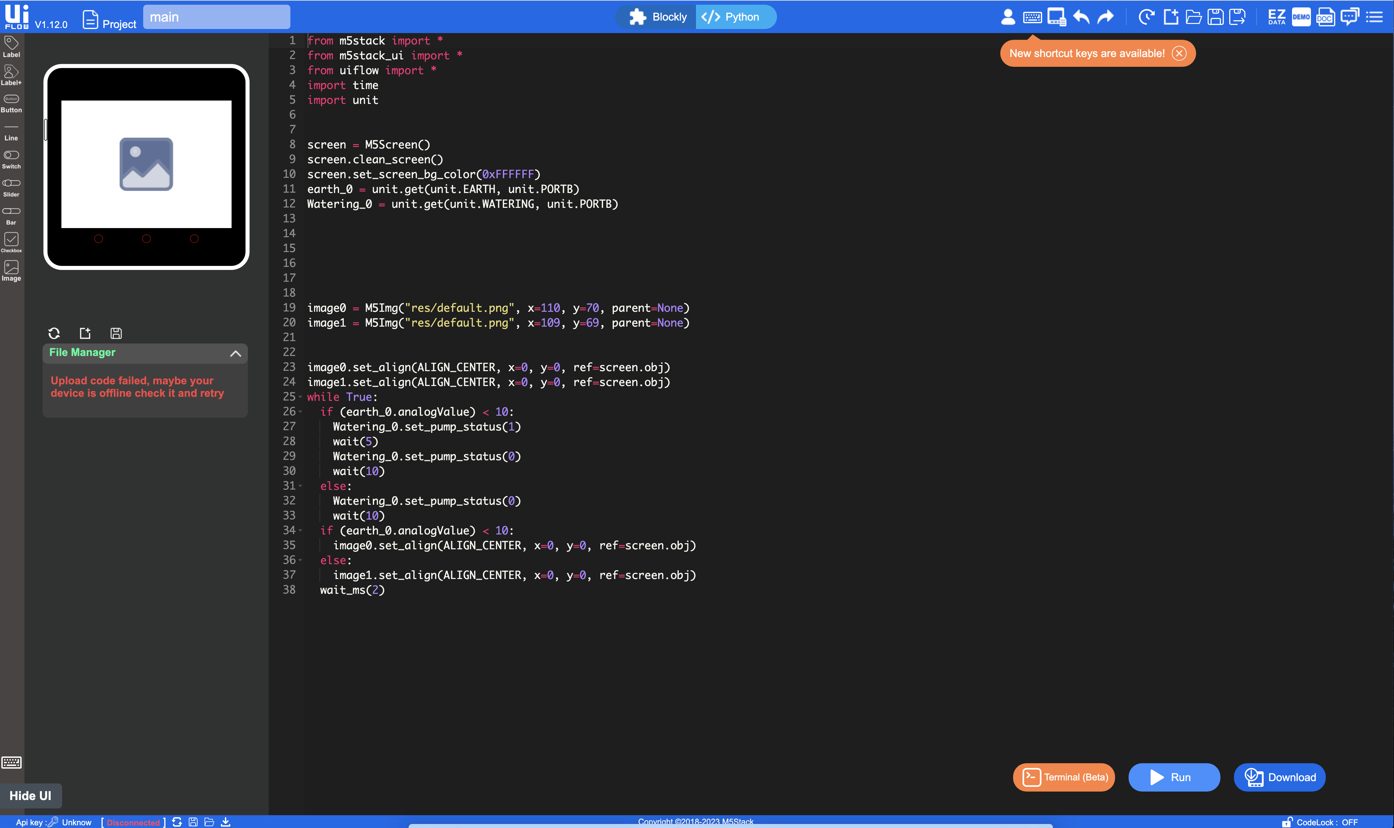
Practical work – In the process of achieving the goal
We finally got to a stage of understanding the code blocks and how to use them that it felt natural to start implementing some level of python. Upon using it on a blank coding canvas, this is what I came up with.
It's a fairly simple script which handles events such as the pump being activated, pressure and timings of the pump, and even handles components asides from the pump, such as changing the screen if the earth moisture reader elapses the 300 moisture value required to change the image of the smiley face.
Upon realising it's fairly simple for me, I asked around my peers to see if they themselves had utilized python for their models. I got a mixed result, however I did get the general consensus that, why implement a more complicated way of attaining the same goal you could otherwise achieve with the much simpler block code? This got me thinking and eventually started the discussion on why should we use python?

Slide 10
Why implement python?
Throughout the task after receiving the feedback from those I asked, I kept thinking back and questioning myself – why should we use python?
To me block code seemed like the much better option – it allowed a much faster and digestible interface

Slide 11
Conclusion
The day was successfully finished in what we had planned as our goal; developed an IoT device which utilizes several components and code language to a high standard depending on our skill level at that time.
If I were to do this again, I would implement python more frequently rather than relying on the block code, as upon further research on how to deal with syntax errors as well as clarity on how I can depict and describe the python code, it'll feel much more natural if I were to do this task in the future another time.

Slide 12
Stuff not in the presentation yet (remove slide upon completion)
https://catalog.workshops.aws/sustainability-hackathon/en-US

Slide 13

